Slide 1
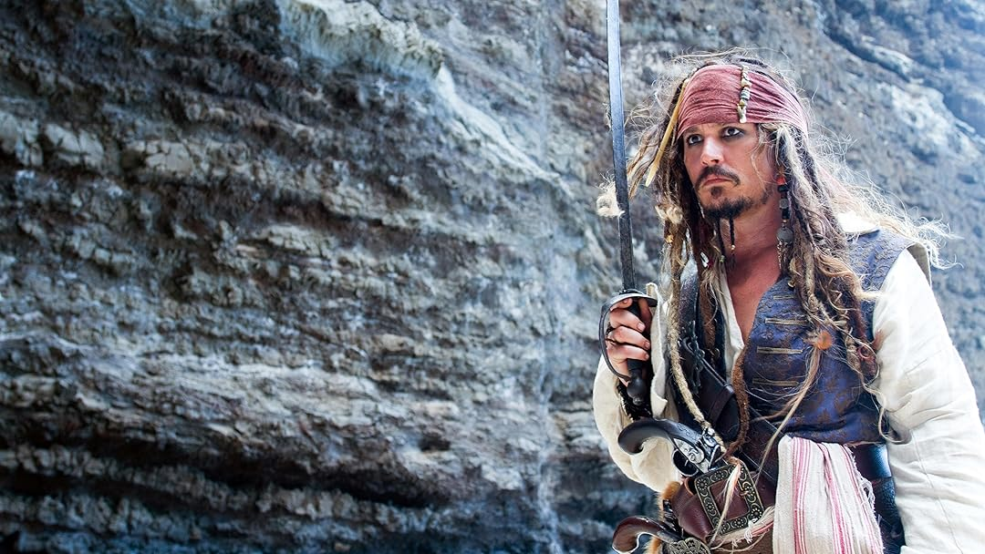
Why piracy is getting popular?
(again)

Slide 2





What is piracy?

Slide 3
Movies & TV piracy

Slide 4
Games piracy

Slide 5
Software piracy

Slide 6
Music piracy

Slide 7
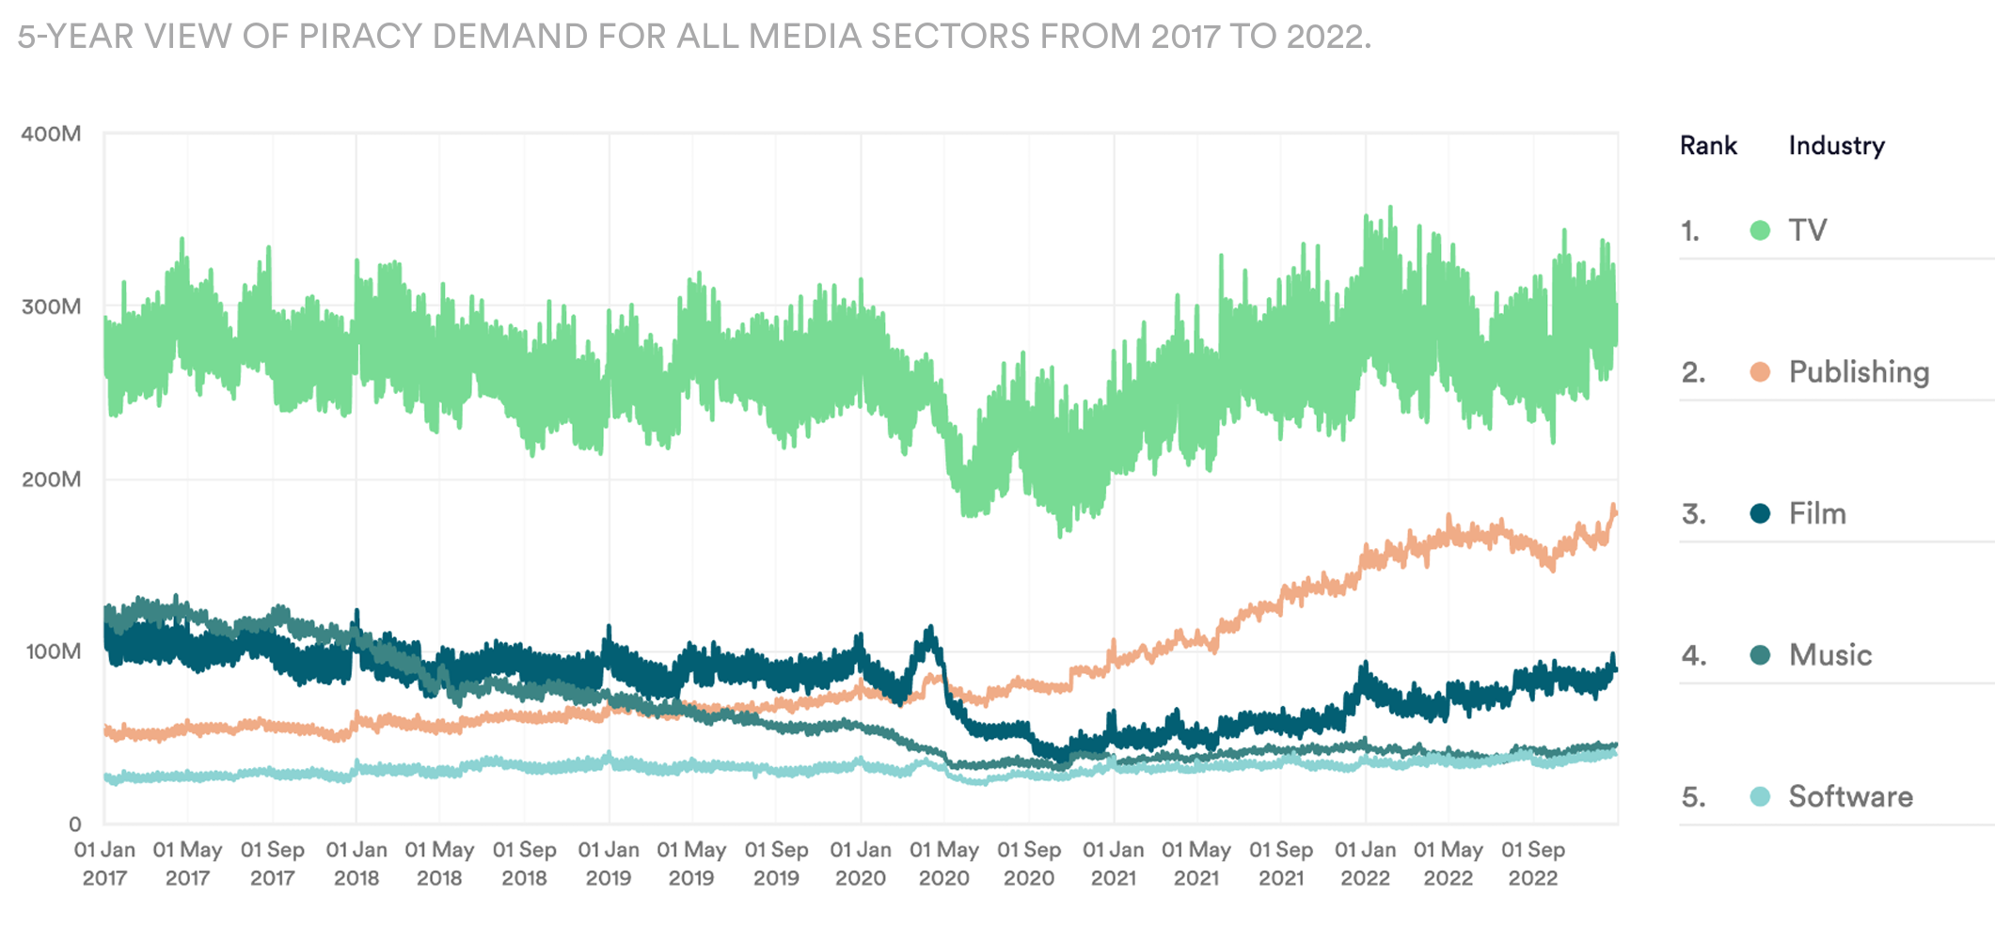
Statistics

Slide 8
End
Thanks for watching Igor Wickowski

